Slide 1
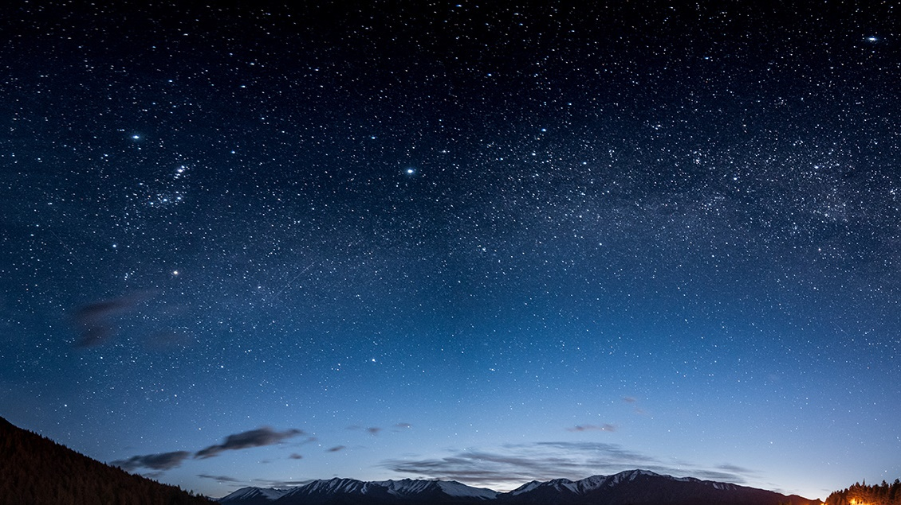
TEAM NAME – TECHNOVICE
TEAM MEMBERS :
1.ANSHIKA AGARWAL
2. ADITI
3. AKANSHA CHAURASIA
4. ANOMA SINGH

Slide 2
PROBLEM STATEMENT- Replicate a Netflix website/application with a celestial touch….
Design a celestial-themed user interface for a streaming platform that replicates the features and functionality of Netflix. The UI should include easy navigation, visually appealing images and videos, personalized recommmendations , user-friendly search functionality, and intuitive categorization of content. The celestial theme should be integrated throughout UI, with a color scheme and visual design that is consistent and visually appealing.

Slide 3
Research and inspiration behind the design..
The research and inspiration behind making a celestial theme replication of Netflix may be a combination of factors, including data analysis, market trends, and brand messaging. The platform has been known for its innovative and boundary-pushing approach to entertainment, and the cosmic theme may symbolize the platform's mission to take viewers on a journey beyond the ordinary and into the unknown.
Nonetheless, the celestial theme has proven to be a timeless and captivating concept, and it's exciting to see how Netflix will bring this theme to life in its content offerings.

Slide 4
Challenges We Faced….
During the hackathon project, we faced several challenges that tested our skills and problem-solving abilities. One of the biggest challenges was time management. We had a limited amount of time to complete the project, and we had to carefully allocate our time to ensure that we could deliver a functional product.
Additionally, we faced challenges in communication and collaboration, especially when working remotely. We had to ensure that everyone was on the same page and that tasks were distributed effectively.
Another challenge was to learn a new technology and building a project within the timeframe of the hackathon

Slide 5
How is Galacticflix better….
Glactic flix provides an interesting celestial theme which is the most loved theme of all time
Since GalacticFlix is a low cost website and hence if promoted will be cost friendly for the users as compared to Netflix.
Also our website is easy and takes less time to navigate as compared to Netflix.
The UI of our website is better as compared to Netflix.

Slide 6
Note for team equinox at celestial biscuit igdtuw
We had enjoyed a lot in this hackathon by designing and thinking with team . We learned a plenty of new things , and the mentorship sessions during the hackathon were very helpful. We are very thankful to all the mentors who helped us during the hackathon period..

Slide 7
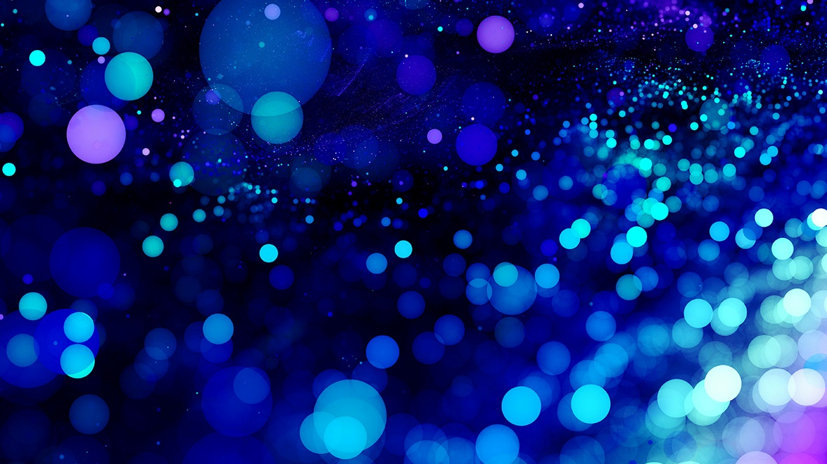
Thank You!
Team technovice

